Slide 1
Computer Vision CMSC 426
Spring 2019

Slide 2


The Team
Cornelia Fermüller, Instructor
Office Hours:
Tu/Th: 1:30pm - 2:30pm
Location: AVW 4459
Email: fer@cfar.umd.edu
Mohammad Nayeem Teli, Instructor
Office Hours:
Tu/Th: 3:00pm - 4:00pm
Location: AVW 1351
Email: nayeem@umd.edu

Slide 3


TAs
Jack Rasiel
Office Hours:
Tu: 4:00pm – 6:00pm
Location: AVW
Email: jrasiel@cs.umd.edu
Shlokk Mishra
Office Hours:
We: 4:00pm - 6:00pm
Location: AVW
Email: shlokk@cs.umd.edu

Slide 4
Logistics
Four projects, and three homework assignments (programming + discussion): in groups of three
Midterm exam: in class
All information available from the Website
Grading
Projects 50 %
Homework 25%
MidTerm 20%
Class Participation 5%

Slide 5
Programming
Matlab
Instructions for installing and a Tutorial available from the website.

Slide 6
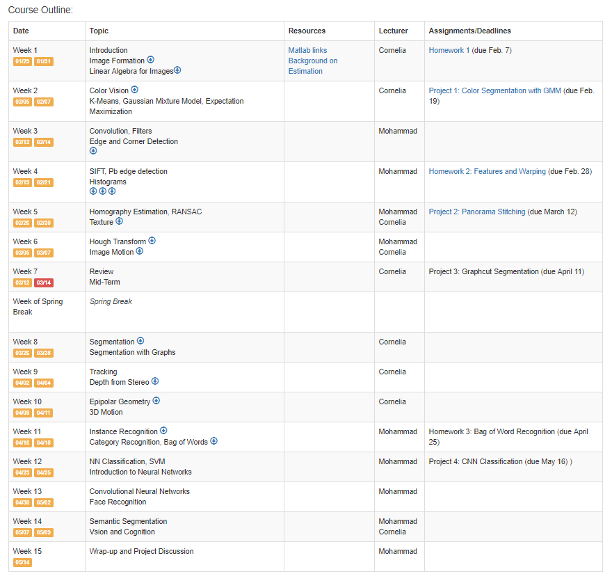
Schedule (link)

Slide 7
Schedule
The dates for Projects and HWs – when they will made available and when they are due –are set.
In addition, we will make an effort to make projects available before this date (about a week)
Make an effort to submit in time! We will give 5 days extension for a 20% reduction in points

Slide 8
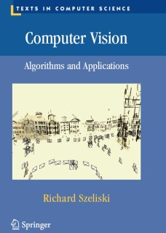
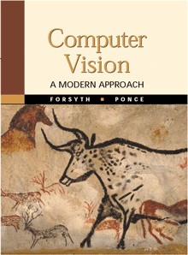
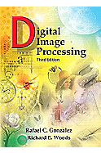
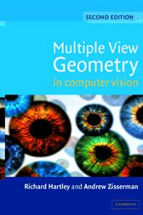
Recommended Texts
Computer Vision: Algorithms and Application, Richard Szeliski
Online: http://szeliski.org/Book/
Computer Vision: A Modern Approach
David Forsyth and Jean Ponce,, 2003
Online: http://www.csd.uwo.ca/~olga/Courses/Winter2010/CS4442_9542b/CVbook.pdf
Digital Image Processing, Prentice Hall, Rafael Gonzalez, and Richard Woods, 2008.
Online: http://web.ipac.caltech.edu/staff/fmasci/home/astro_refs/Digital_Image_Processing_2ndEd.pdf
Multiple View Geometry in Computer Vision
Richard Hartley and Andrew Zisserman University Press, 2004,
selected chapters available online: http://www.robots.ox.ac.uk/~vgg/hzbook/

Slide 9
What is vision?
From the 3-D world to 2-D images: image formation (physics).
Domain of artistic reproduction (synthesis): painting, graphics.
From 2-D images to the 3-D world: image analysis (mathematical modeling, inference).
Domain of vision: biological (eye+brain), computational
Many introductory slides from Jana Kosecka

Slide 10
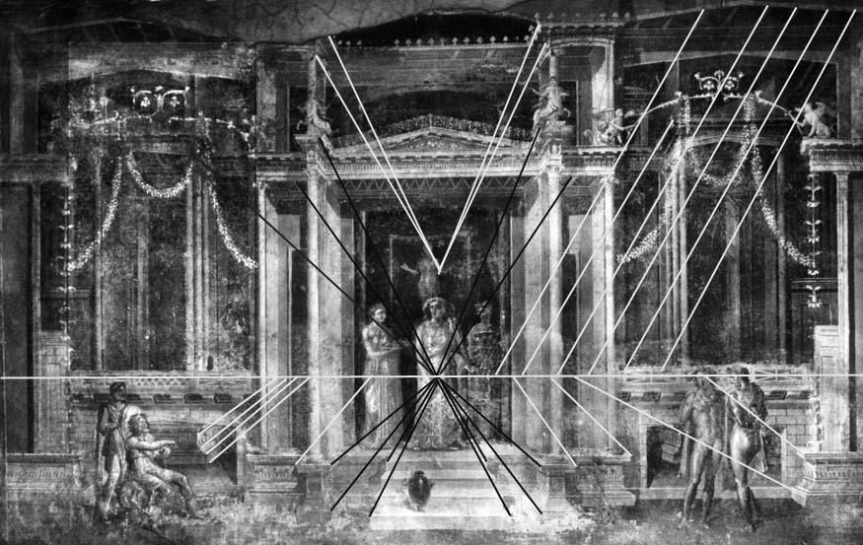
IMAGE SYNTHESIS: image-formation process
Pinhole (perspective) imaging in most ancient civilizations.
Euclid, perspective projection, 4th century B.C., Alexandria (Egypt)
Pompeii frescos, 1st century A.D. (ubiquitous).
Geometry understood very early on, then forgotten.
Image courtesy of C. Taylor

Slide 11
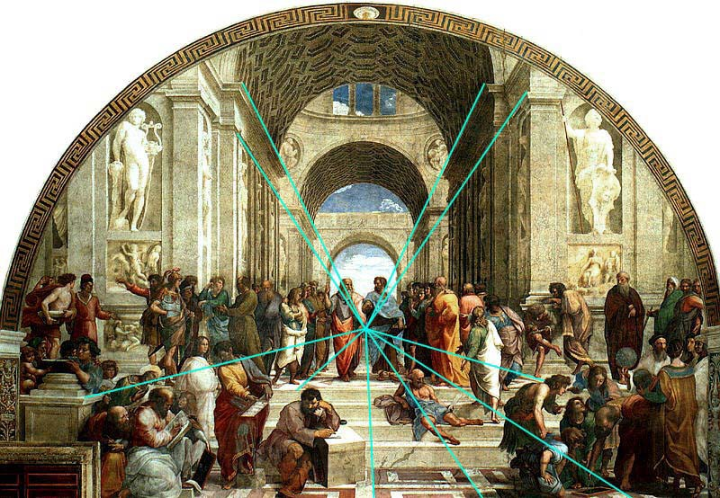
PERSPECTIVE IMAGING (geometry)
Re-discovered and formalized in the Renaissance:
Fillippo Brunelleschi, first Renaissance artist to paint with correct perspective,1413
“Della Pictura”, Leon Battista Alberti, 1435, first treatise
Leonardo Da Vinci, stereopsis, shading, color, 1500s
Raphael, 1518
Image courtesy of C. Taylor

Slide 12
Goals of Computer Vision
Build machines and develop algorithms which can automatically replicate some functionalities of biological visual system
Systems which navigate in cluttered environments
Systems which can recognize objects, activities
Systems which can interact with humans/world
Synergies with other disciplines and various applications Artificial Intelligence - robotics, natural language understanding
Vision as a sensor - medical imaging, Geospatial Imaging, robotics, visual surveillance, inspection

Slide 13



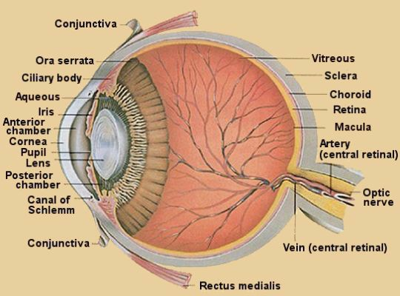


image appearance depends on structure of the scene
material and reflectance properties of the objects
position and strength of light sources

Slide 14
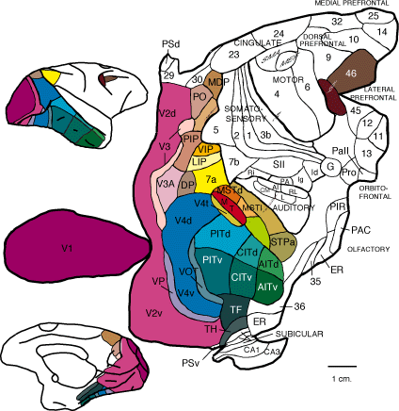


Visual Information Processing
This is the part of your brain that processes visual information
[Felleman & Van Essen, 1991]

Slide 15
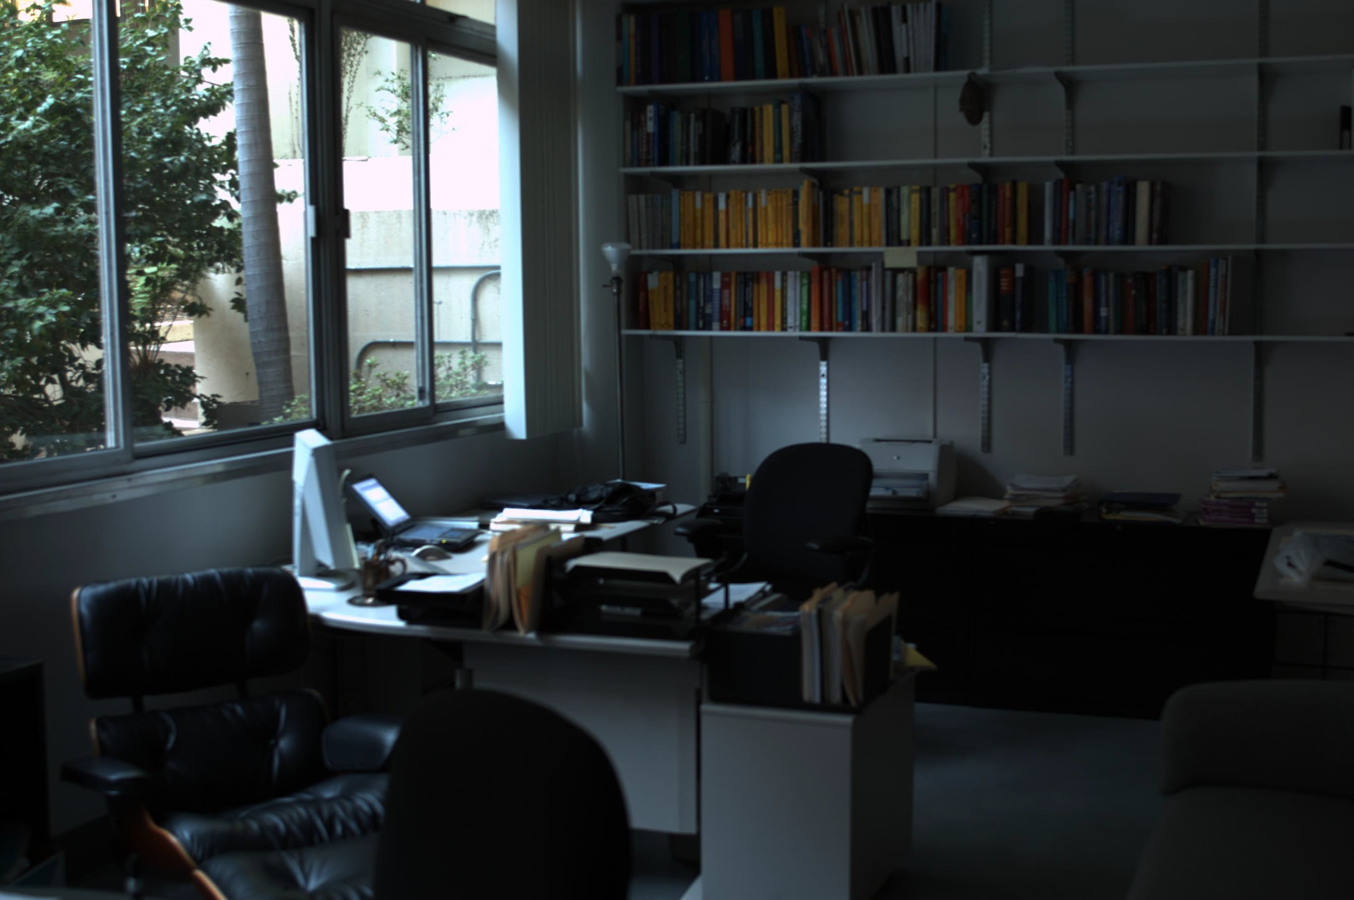
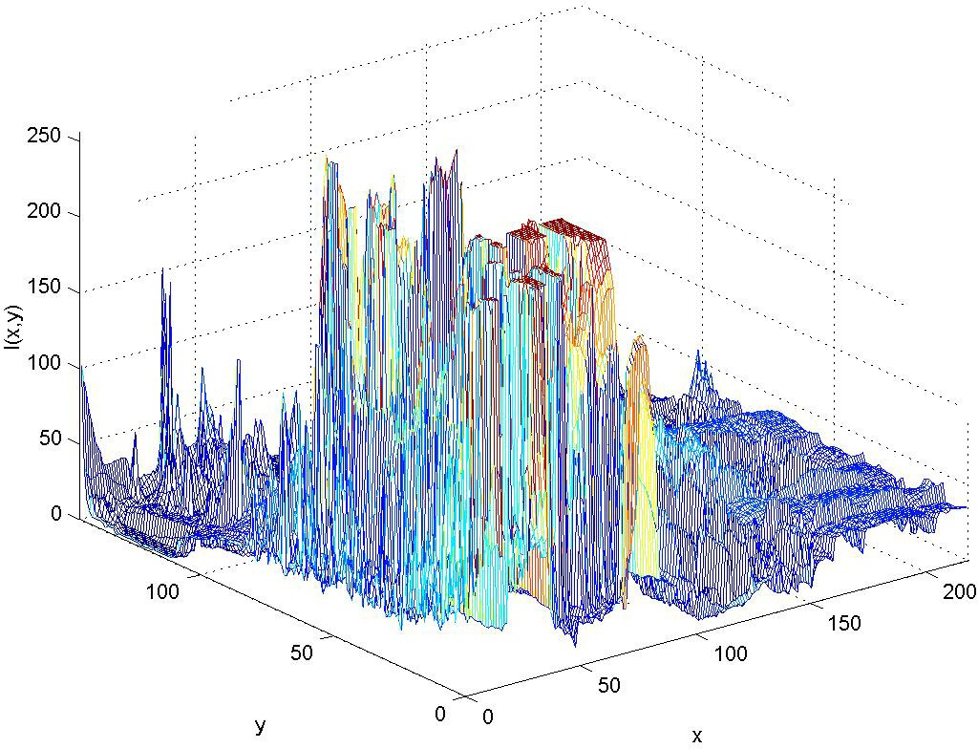
This is how a computer represents it

Slide 16
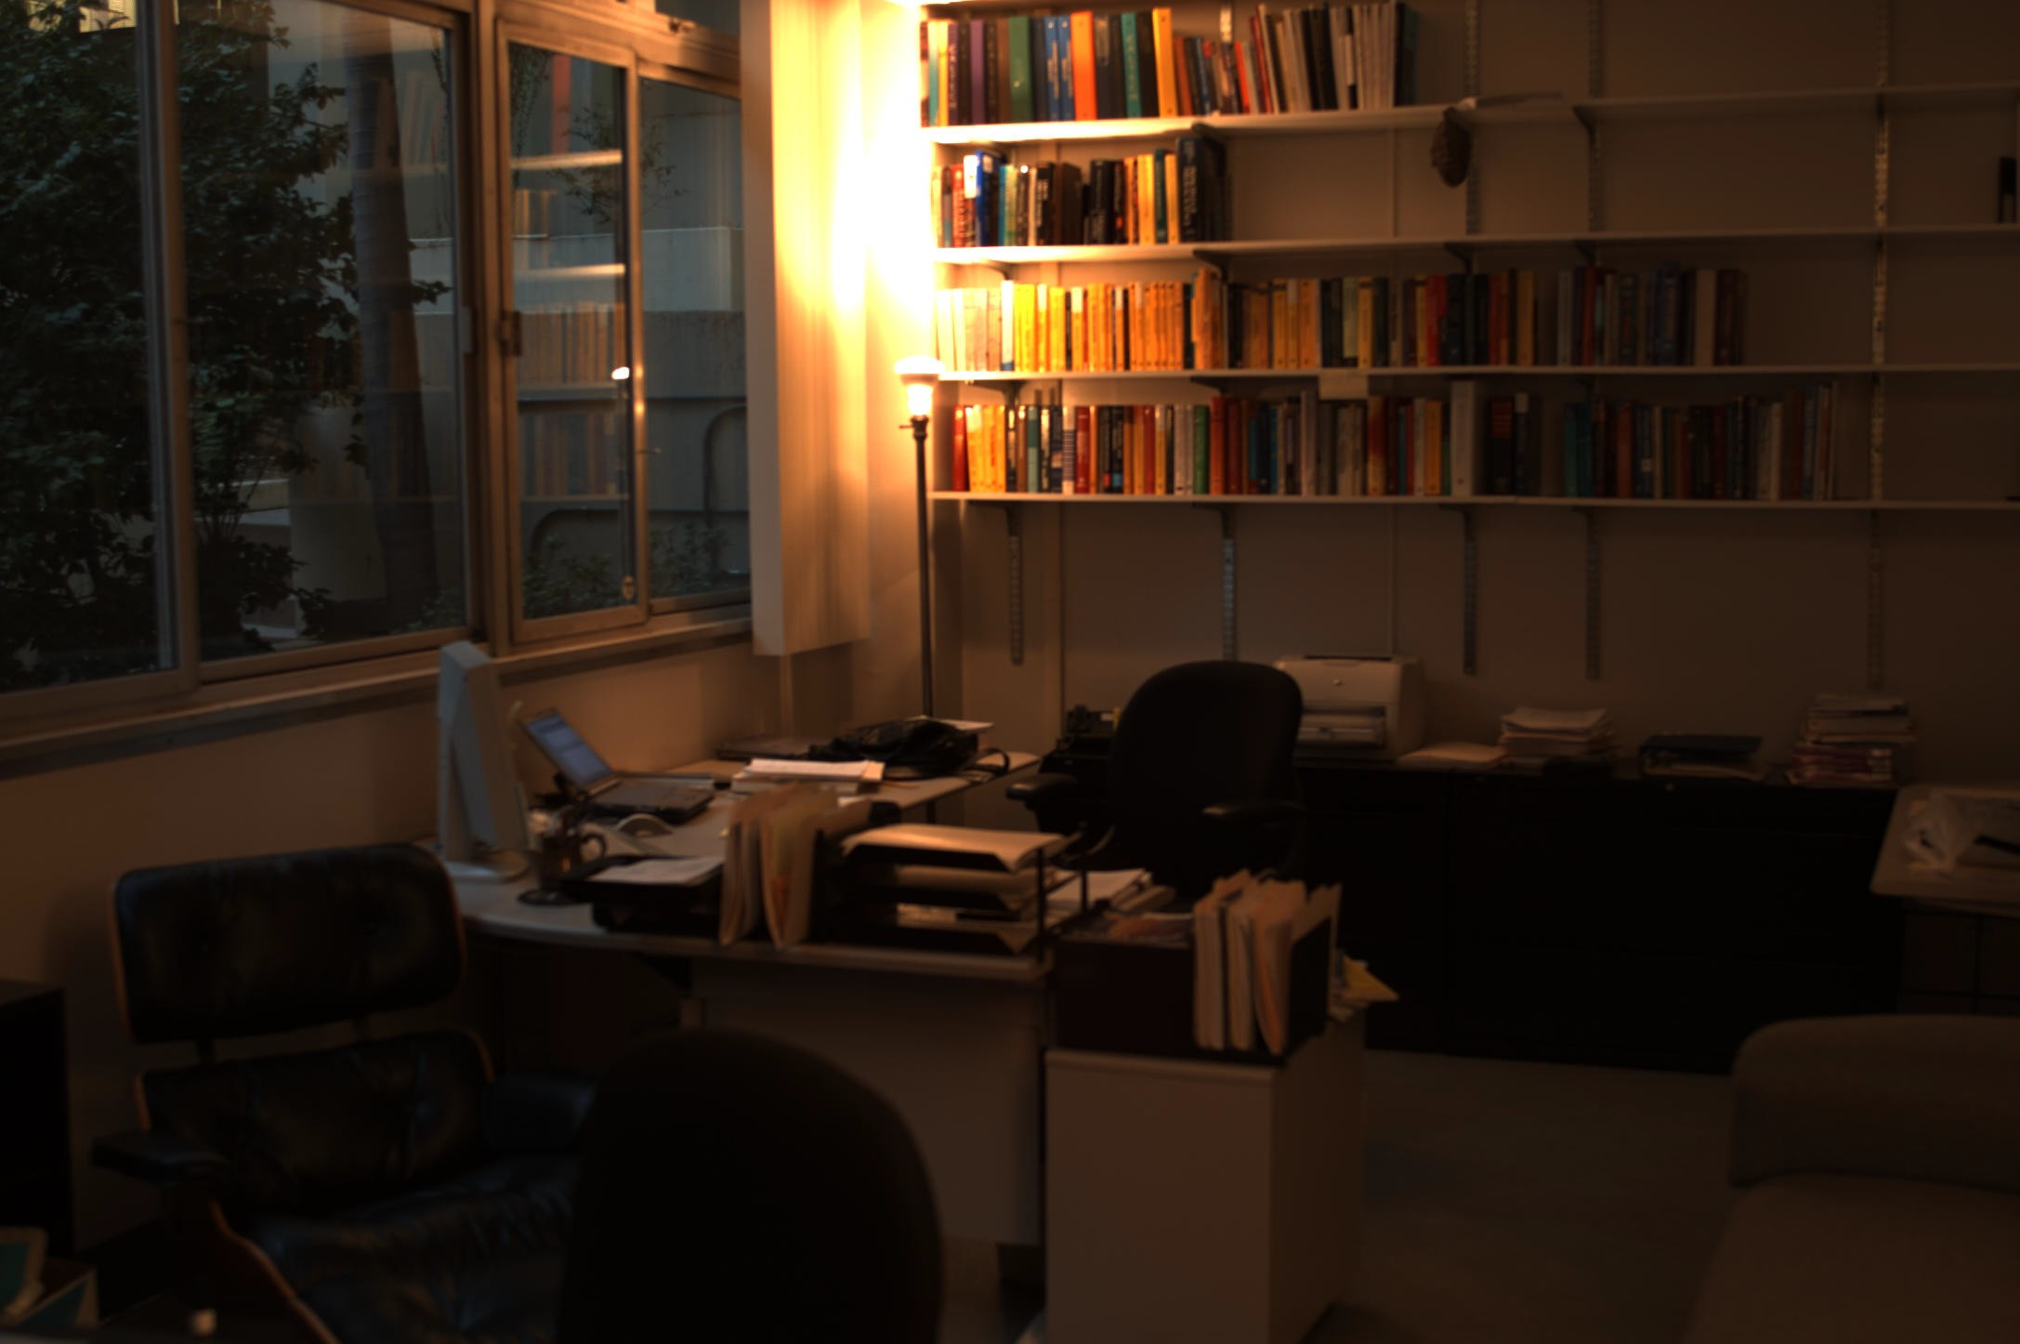


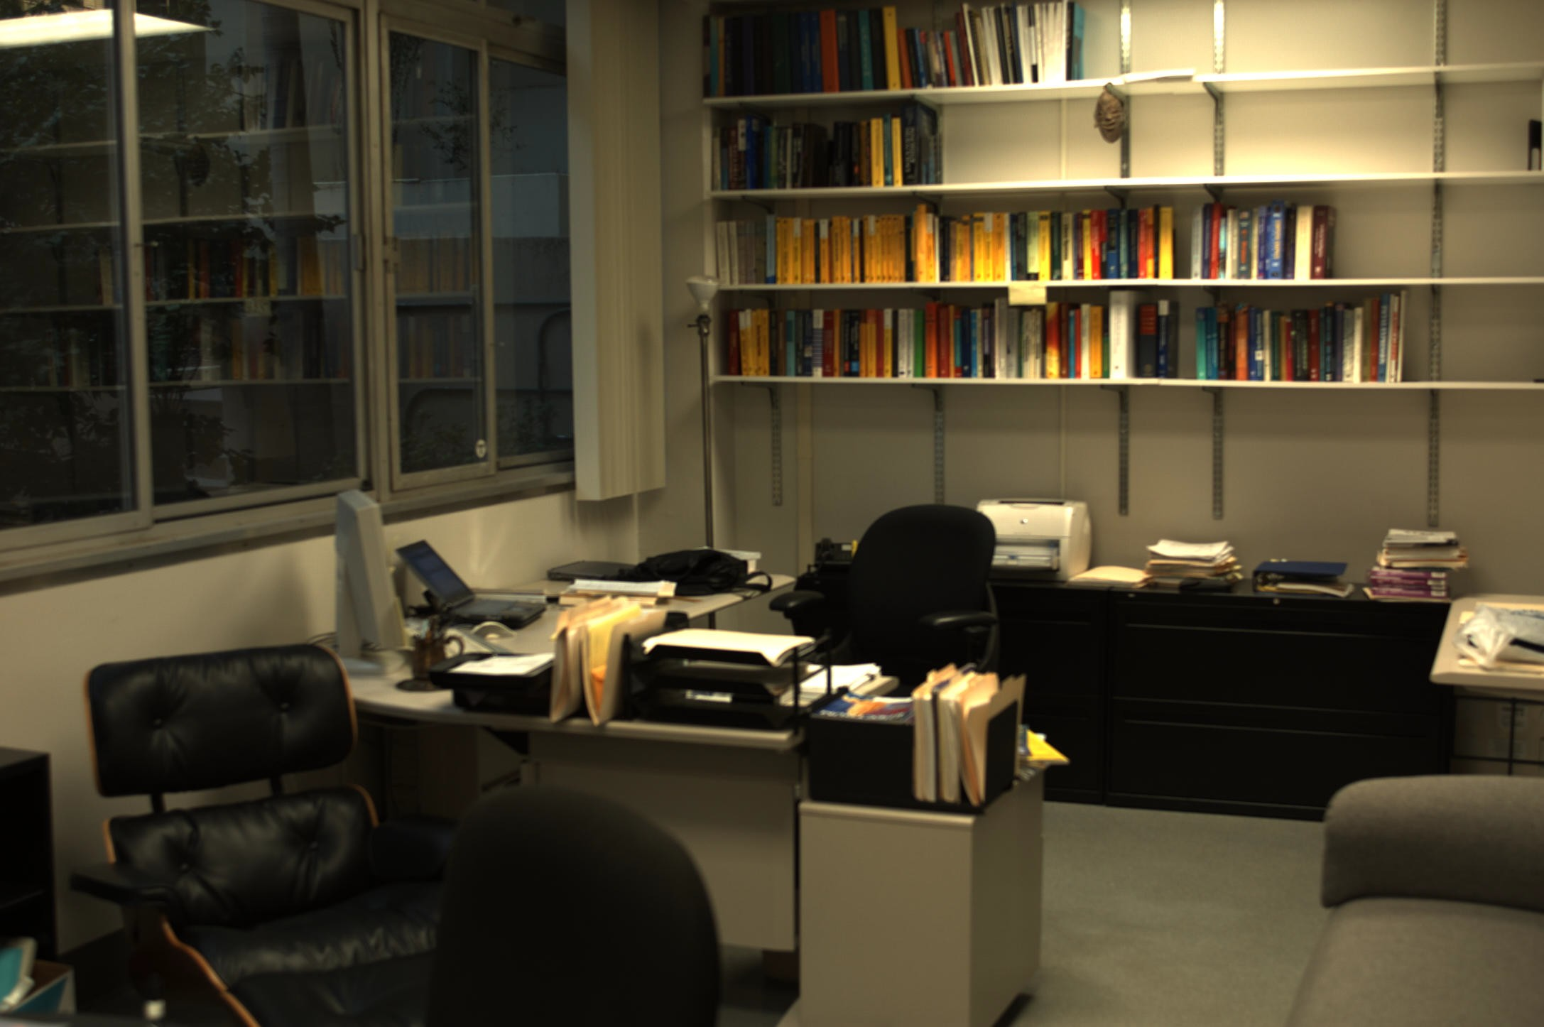
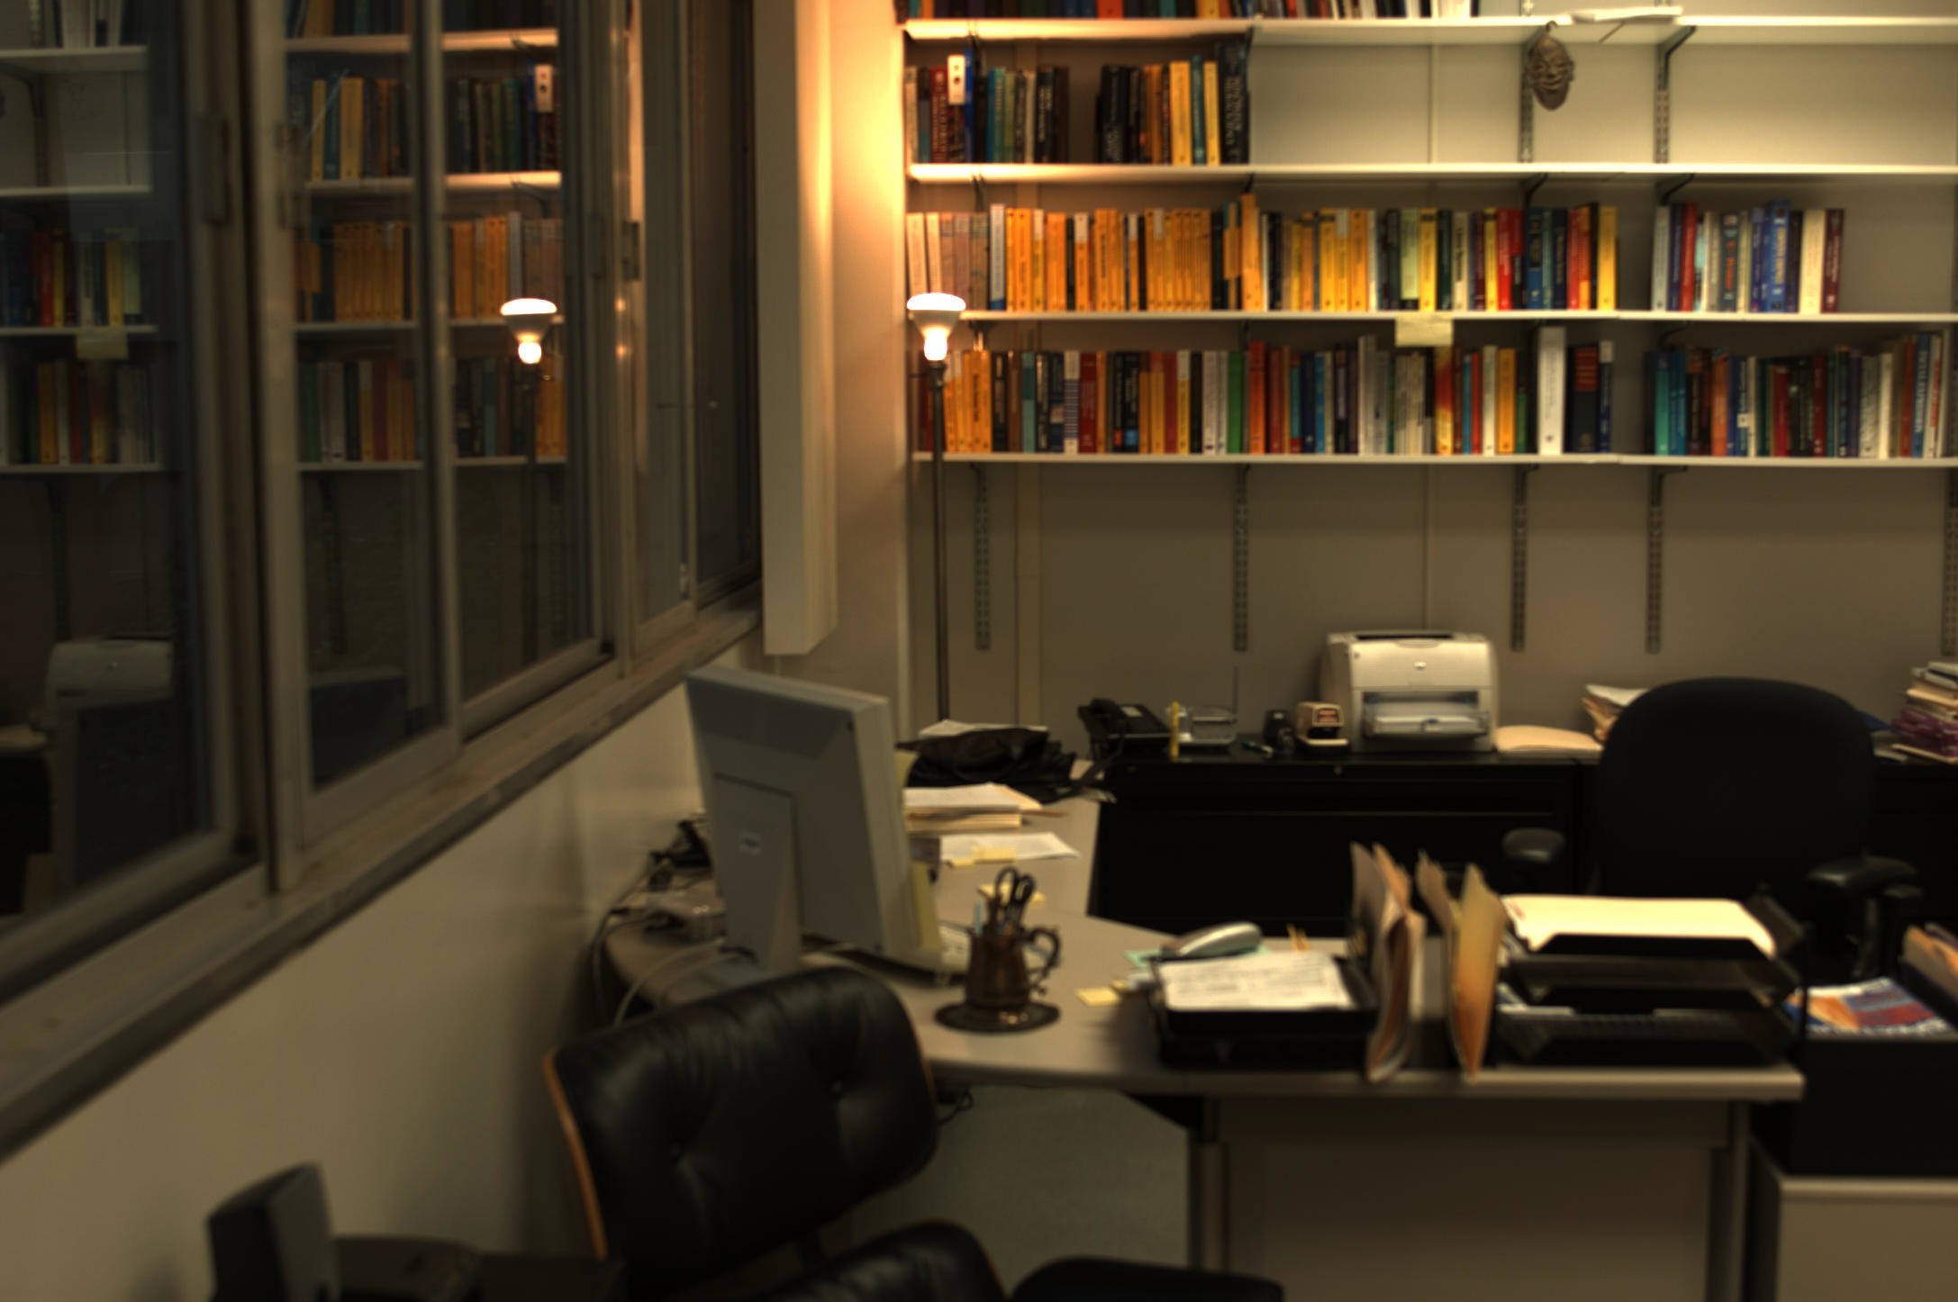
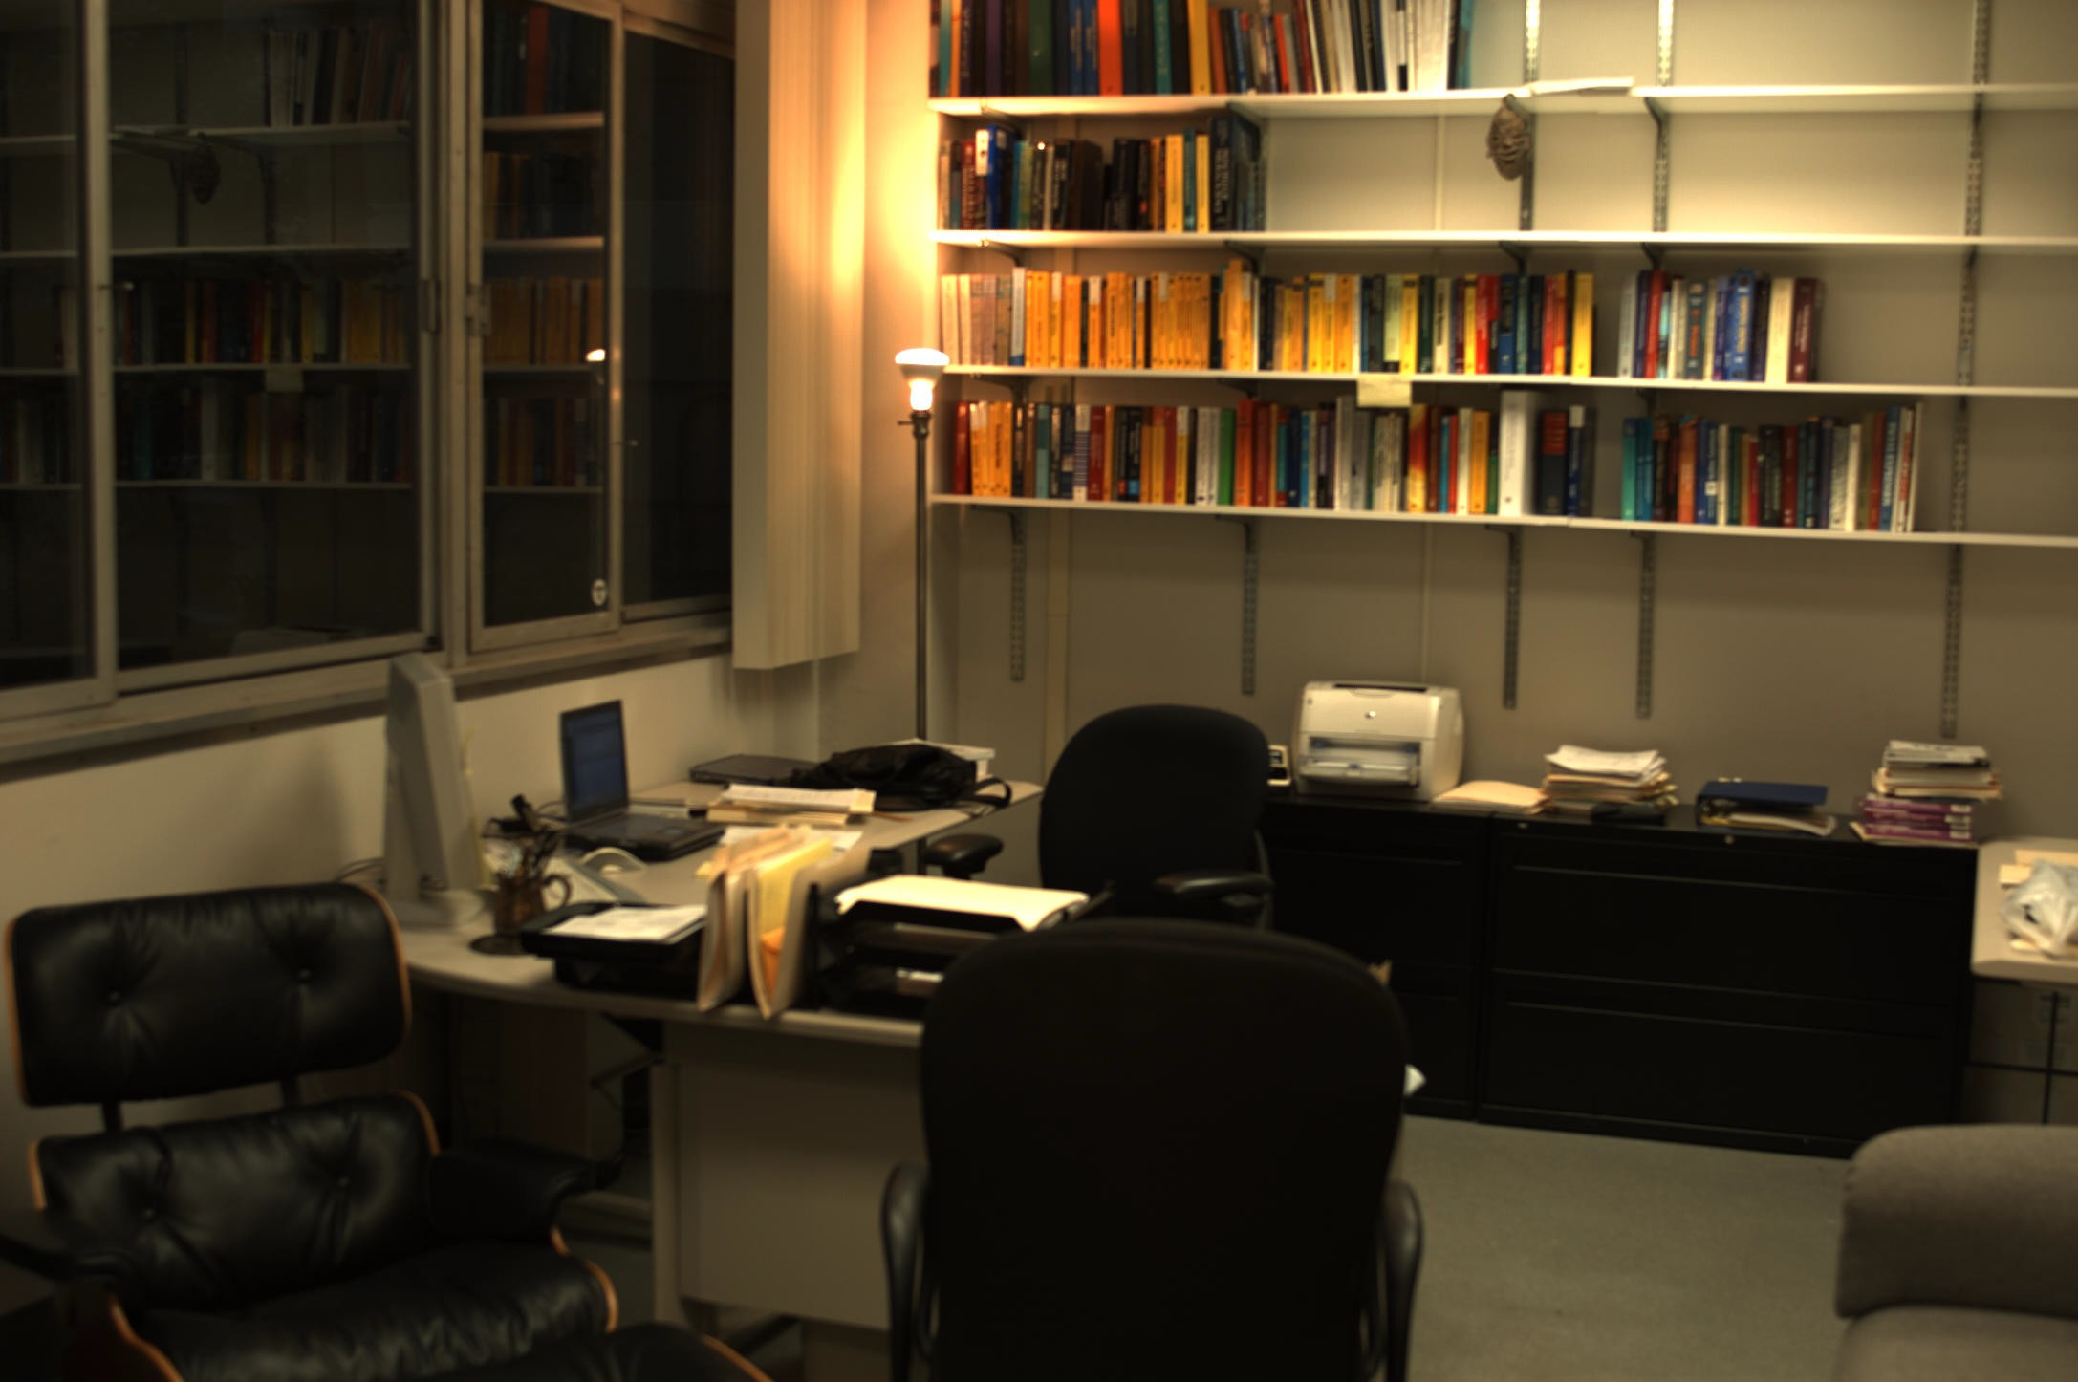
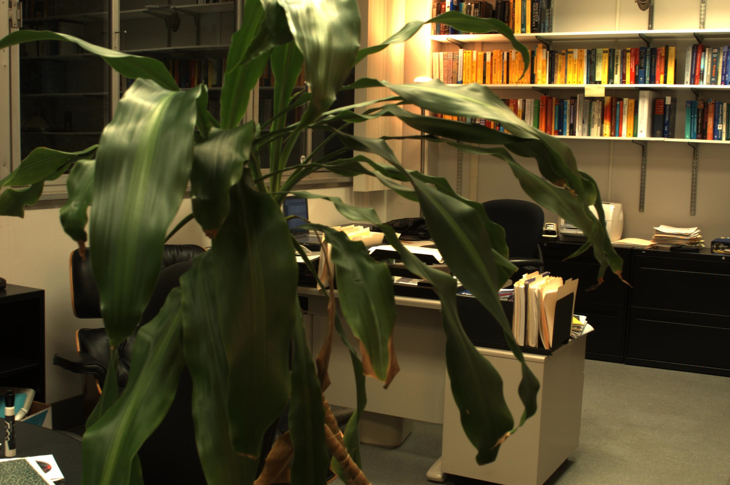
And so is this …

Slide 17
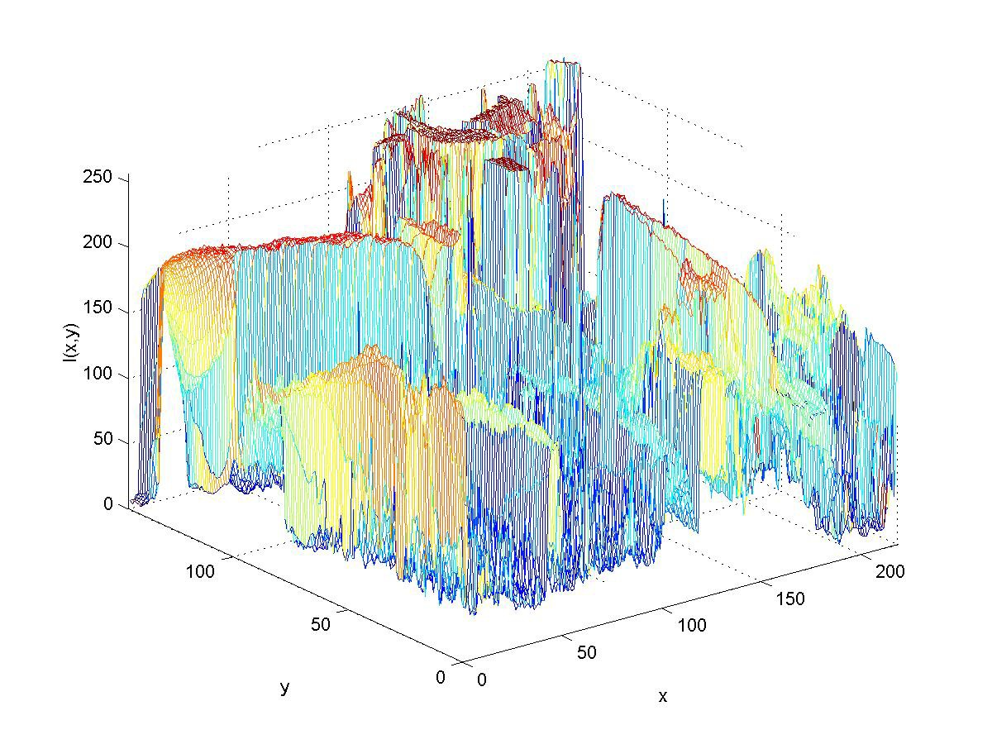
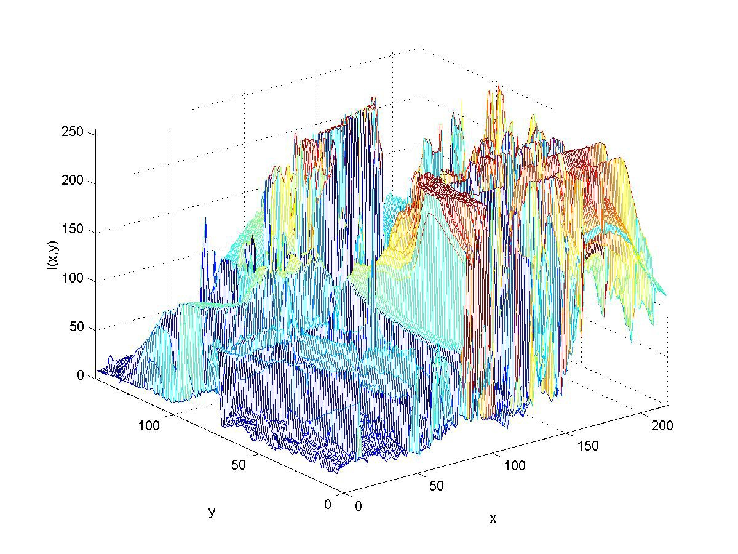
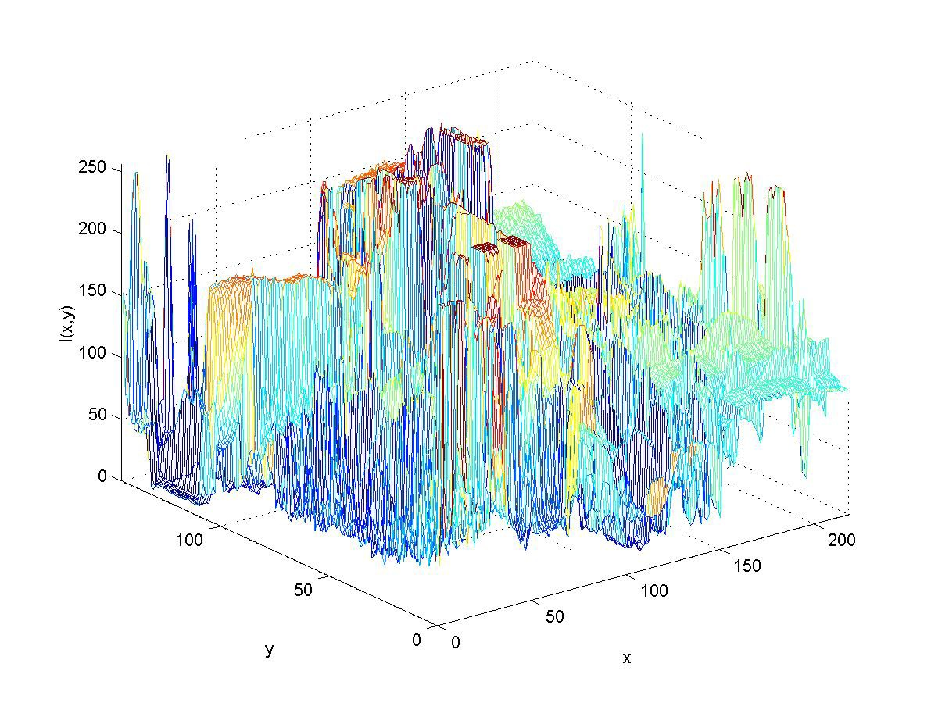
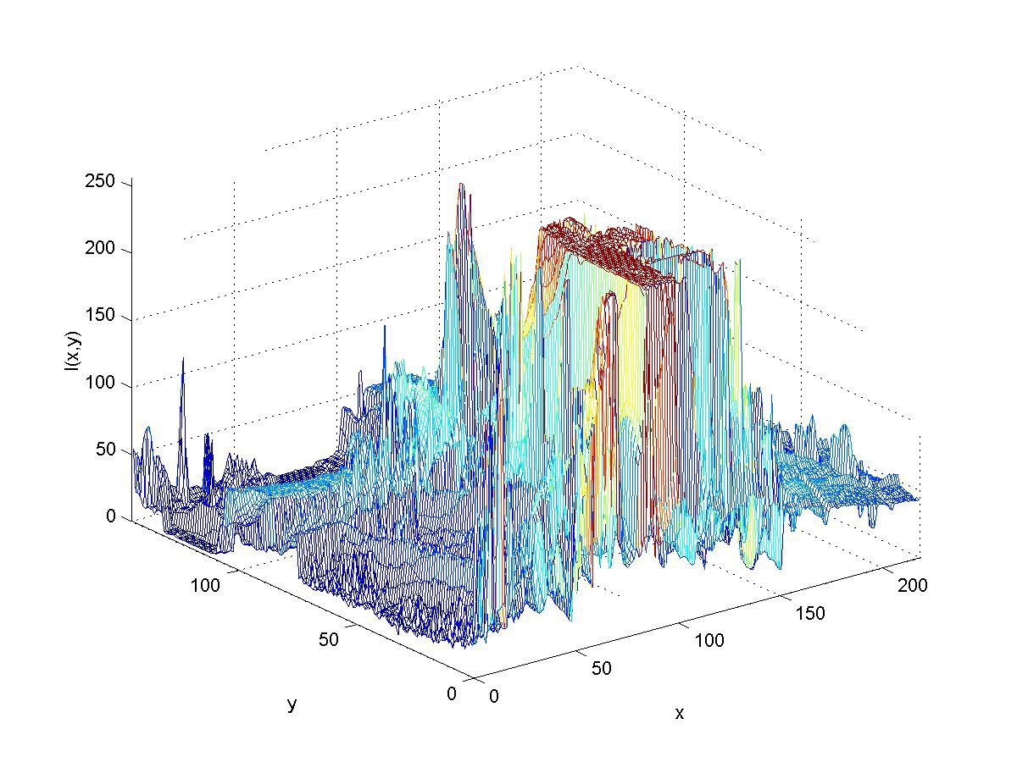
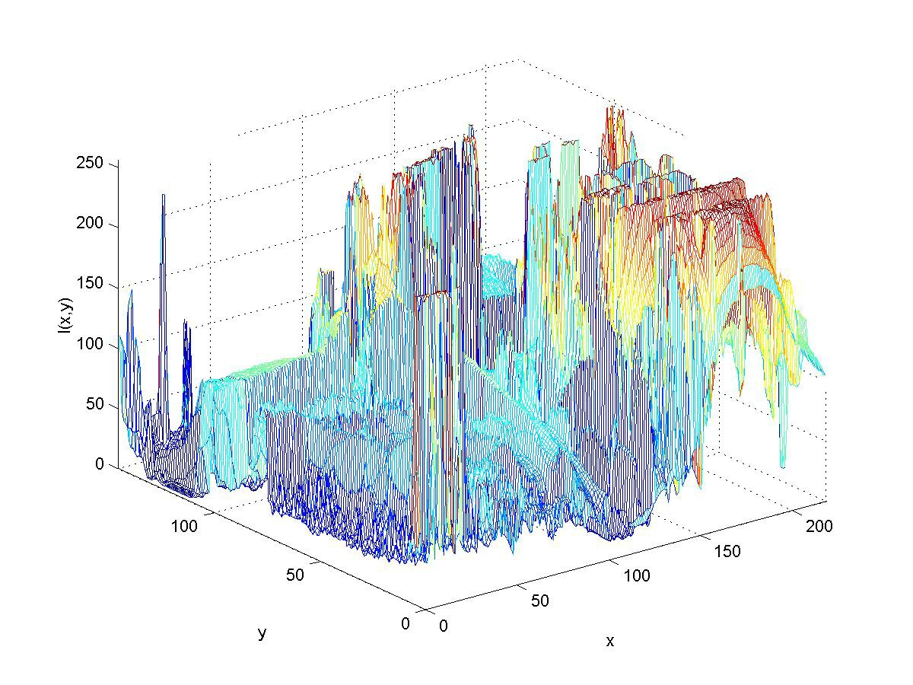
And so are these!
We need to extract some “invariant”, i.e. what is common to all these images (they are all images of an office)

Slide 18
BUMMER! THIS IS IMPOSSIBLE!
THM: [Weiss, 1991]: There exists NO generic viewpoint invariant!
THM: [Chen et al., 2003]: There exists NO photometric invariant!!
So, how do we (primates) solve the problem?

Slide 19
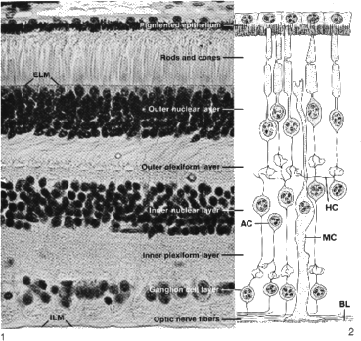
EXAMPLE OF A (VERY COMMON) SENSOR NETWORK
Retina performs distributed computation:
Contrast adaptation (lateral inhibition)
Enhancement/edgels (e.g.
Mach bands)
Motion detection (leap frog)

Slide 20

Optical Illusion
Look at the crosses they appear to be gray

Slide 21
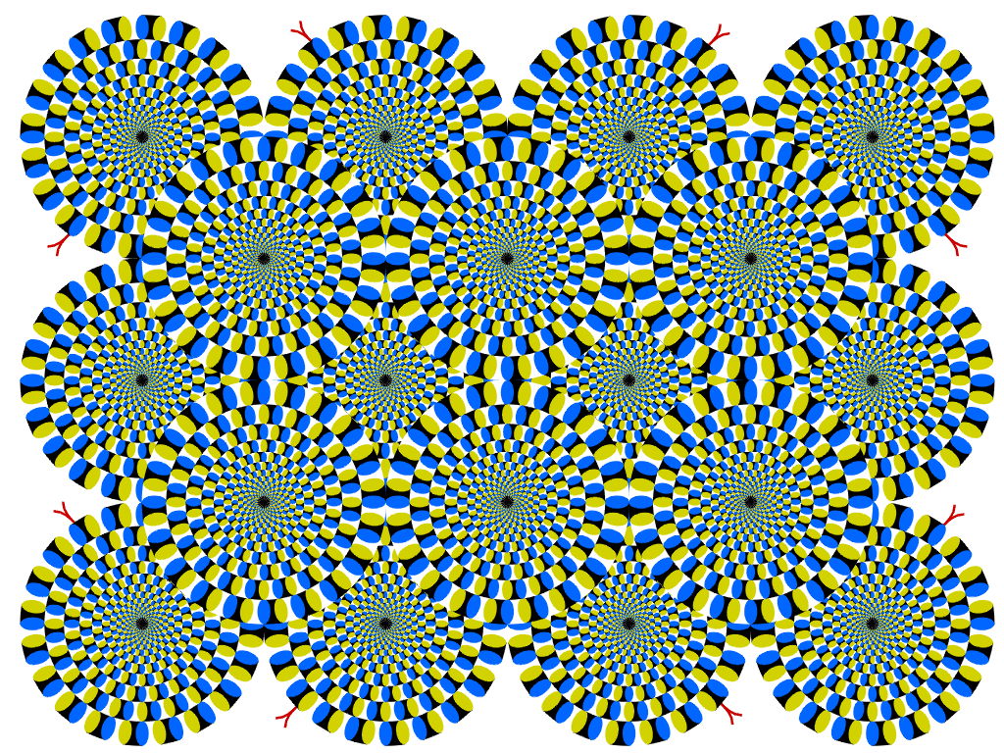
Optical Illusion
Rotating Snakes (Kitaoka)

Slide 22
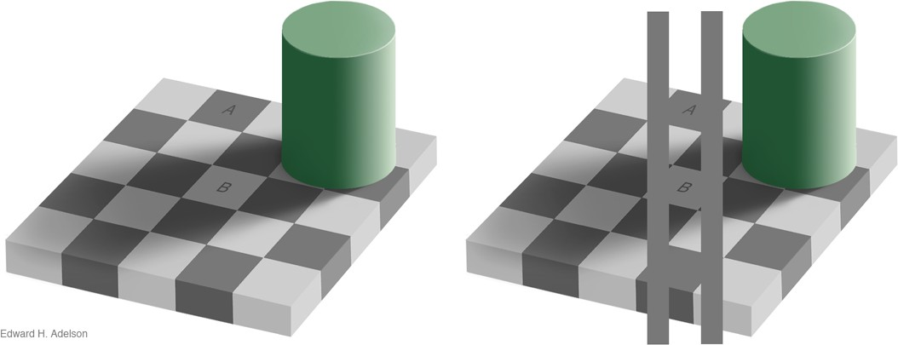
Optical Illusion
Checker A and B are of the same gray-level value
http://web.mit.edu/persci/people/adelson/checkershadow_illusion.html

Slide 23


About 40% of our brain is devoted to vision
We see immediately and can form and understand images instantly
Applications and examples

Slide 24
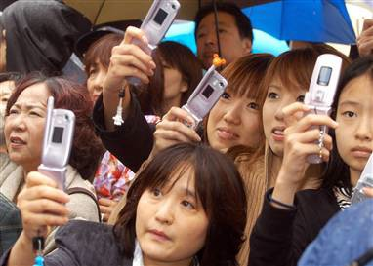
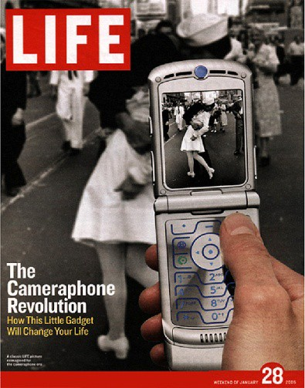
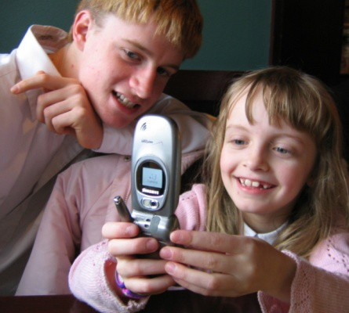
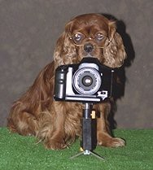
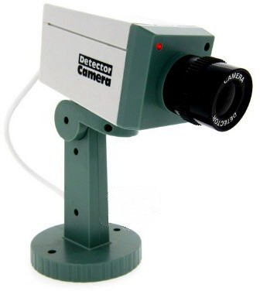
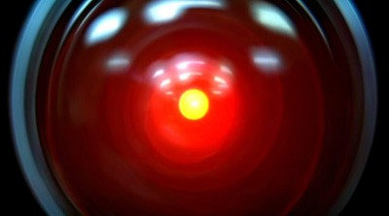
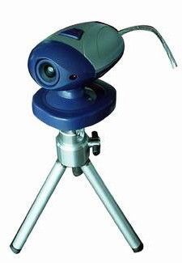
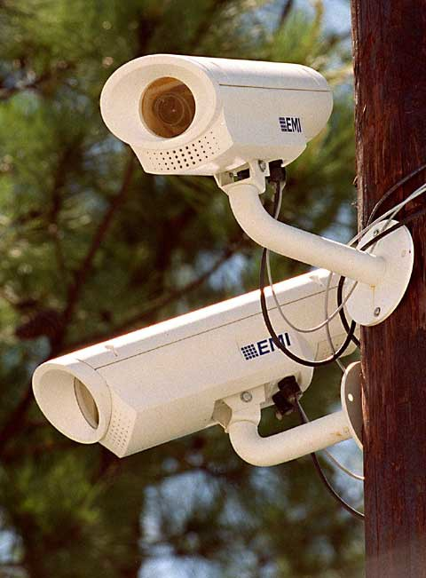
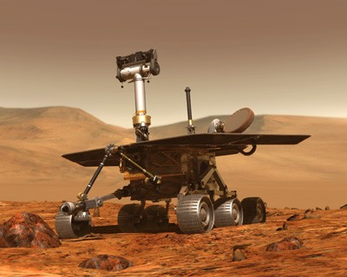
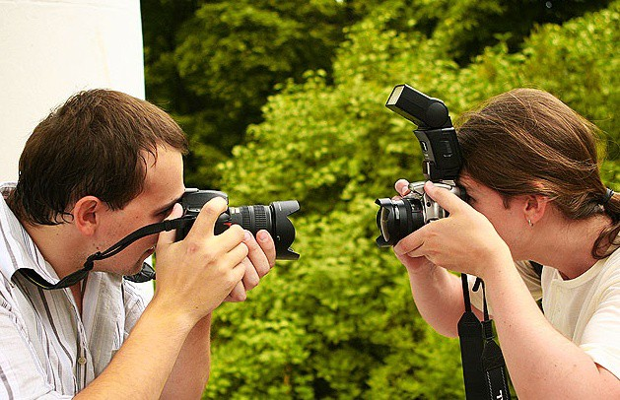
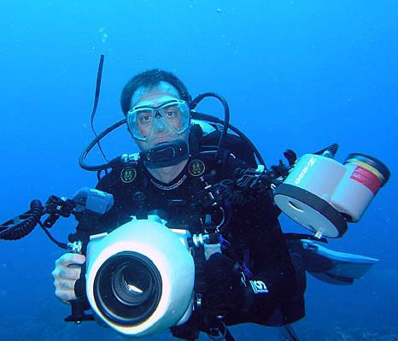
COMP 7
7
6: Comput
e
r Vision

Slide 25
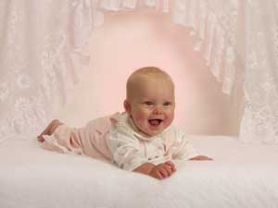
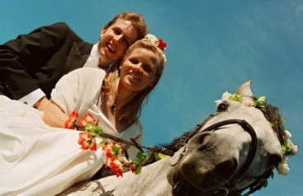
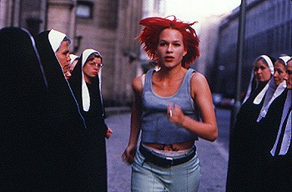
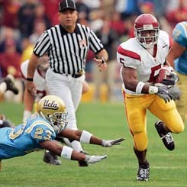
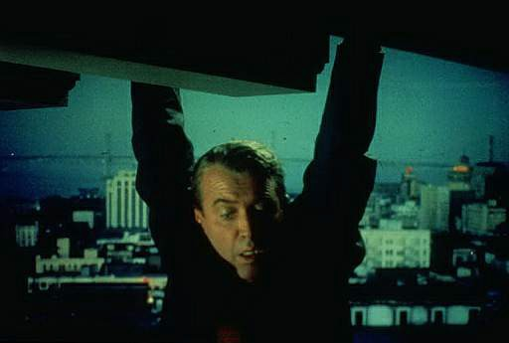


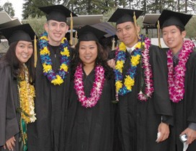
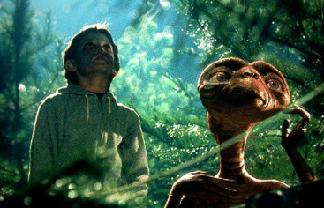

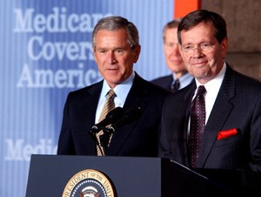
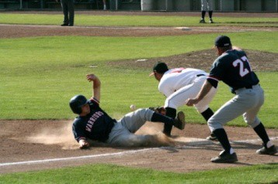






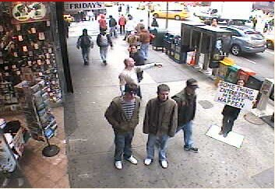
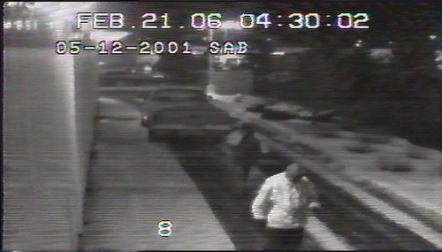
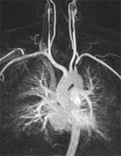
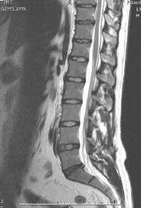
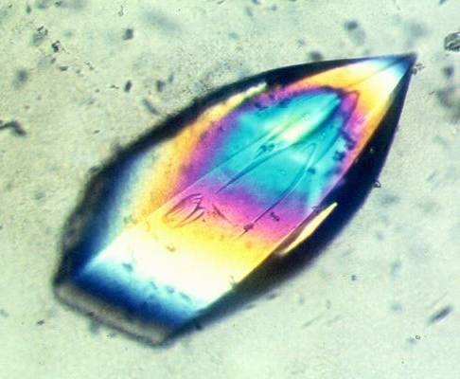
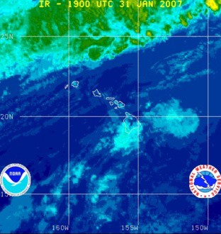








Why study computer vision?
Vision is useful: Images and video are everywhere!

Slide 26




Vision as measurement device
over

Slide 27

Vision as a source of semantic information
slide credit: Fei-Fei, Fergus & Torralba

Slide 28
Object categorization
sky
building
flag
face
banner
wall
street lamp
bus
bus
caslridse credit: Fei-Fei, Fergus & Torralba

Slide 29



Challenges: viewpoint variation
Michelangelo 1475-1564
slide credit: Fei-Fei, Fergus & Torralba

Slide 30

Challenges: illumination
image credit: J. Koenderink

Slide 31

Challenges: scale
slide credit: Fei-Fei, Fergus & Torralba

Slide 32

Challenges: deformation
Xu, Beihong 1943
slide credit: Fei-Fei, Fergus & Torralba

Slide 33

Challenges: occlusion
Magritte, 1957
slide credit: Fei-Fei, Fergus & Torralba

Slide 34

Challenges: background clutter

Slide 35

Challenges: Motion

Slide 36






Challenges: object intra-class variation
slide credit: Fei-Fei, Fergus & Torralba

Slide 37





Challenges: local ambiguity
slide credit: Fei-Fei, Fergus & Torralba

Slide 38

Challenges or opportunities?
Images are confusing, but they also reveal the structure of the world through numerous cues
Our job is to interpret the cues!
Image source: J. Koenderink

Slide 39

Depth cues: Linear perspective

Slide 40

Depth cues: Aerial perspective

Slide 41

Shape cues: Texture gradient

Slide 42

Shape and li
ghting cues: Shading
Source: J. Koenderink

Slide 43

Grouping cues: Similarity (color, texture, proximity)

Slide 44

Grouping cues: “Common fate”
Image credit: Arthus-Bertrand (via F. Durand)

Slide 45


Slide 46














Connections to other disciplines
Artificial Intelligence
Robotics
Machine Learning
Computer Vision
Computer Graphics
Cognitive science Neuroscience
Image Processing

Slide 47

Stereo
Example of stereo pipeline, from raw data, preprocessing, meshes, texture maps
See http://schwehr.org/photoRealVR/example.html

Slide 48


Structure From Motion
http://www.cs.unc.edu/Research/urbanscape

Slide 49

Structure From Motion
http://www.cs.unc.edu/Research/urbanscape

Slide 50

Example 2: Structure From Motion
http://www.cs.unc.edu/Research/urbanscape

Slide 51


3D Modeling
http://www.photogrammetry.ethz.ch/research/cause/3dreconstruction3.html

Slide 52




Special effects: shape and motion capture
Source: S. Seitz

Slide 53

Face recognition: Apple iPhoto software
http://www.apple.com/ilife/iphoto/

Slide 54




Biometrics
How the Afghan Girl was Identified by Her Iris Patterns
Source: S. Seitz

Slide 55


Classification

Slide 56




Biometrics
Fingerprint scanners on many new laptops, other devices
Face recognition systems now beginning to appear more widely http://www.sensiblevision.com/
Source: S. Seitz

Slide 57


Optical character recognition (OCR)
Technology to convert scanned docs to text
If you have a scanner, it probably came with OCR software
Digit recognition, AT&T labs
License plate readers http://en.wikipedia.org/wiki/Automatic_number_plate_recognition
Source: S. Seitz

Slide 58


Mobile visual search: Google Goggles

Slide 59


Google Art Museum Project
Navigate museums of the world

Slide 60


Slide 61

Automotive safety
Mobileye: Vision systems in high-end BMW, GM, Volvo models
– “In mid 2010 Mobileye will launch a world's first application of full emergency braking for collision mitigation for pedestrians where vision is the key technology for detecting pedestrians.”
Source: A. Shashua, S. Seitz

Slide 62

Vision in supermarkets
LaneHawk by EvolutionRobotics
“A smart camera is flush-mounted in the checkout lane, continuously watching for items. When an item is detected and recognized, the cashier verifies the quantity of items that were found under the basket, and continues to close the transaction. The item can remain under the basket,
and with LaneHawk,you are assured to get paid for it… “
Source: S. Seitz

Slide 63




Vision-based interaction (and games)
Nintendo Wii has camera-based IR tracking built in. See Lee’s work at CMU on clever tricks on using it to create a multi-touch display!
Sony EyeToy
Xbox and Kinect sensor
Assistive technologies
Source: S. Seitz

Slide 64
Levels of complexity
Early vision – local operations, compute maps, or statistics of individual pixels (edges, motion fields, depth maps)
Midlevel vision – assembly of local information (segmentation, contour completions, grouping)
Scene analysis – recognition of objects, scenes
Active vision – how to control and use the resources to adjust the sensor to gather additional information
Goal directed vision – control behaviors based on visual information

Slide 65
Contents of the Class
Image Processing, Low-level and Mid-level Vision :
Image sensing, lenses
Non-traditional sensors & perceptual coordinate systems
Photometry and Color
Filtering, correlation, convolution, noise
Fourier transform
Edge detection, Boundary detection
Hough transforms
Features, Corners, SIFT features
Image and Motion
Segmentation
Texture Analysis
Multiple view Geometry for Robotics:
Geometric transforms
Projective geometry
Camera Calibration
Epipolar geometry
Stereopsis
Optical flow
Tracking
Image Recognition
Recognition of specific objects
Recognition using Machine Learning, SVM, HOG features
Recognition using Neural Networks
Applications of Recognition

Slide 66
Short description of Projects

Slide 67

Homework 1
Review of estimation
LS estimation TLS estimation , LS with Regularization and RANSAC, applied to the problem of line fitting

Slide 68


Project 1: Color Segmentation with GMM
Detect the ball in images “seen” by Nao.
You will learn about Color imaging
and about Clustering approaches (K-mean and GMMs)

Slide 69

Homework 2: Image Features and Warping
The project involves: corner detection and
geometric transformations between image planes

Slide 70

Project 2: Panorama Stitching
Use the image features to derive the transformation between images and blend them.

Slide 71

Project 3: Segmentation with Graphcuts
Segment foreground from background in log-polar coordinates using
Edge, Color, Texture, and Motion information.

Slide 72


Homework 4: Affine Lucas Kanade Tracker
You will learn about gradient based approaches in video processing
to obtain flow and tracking

Slide 73

Homework 3:Image classification using HOGs and Bag of Words

Slide 74
Project 4:Image classification using CNNs
Write a CNN, then train it as a classifier

